Slide 1
Short Introduction to IES
Based on version 4.1.0

Slide 2
What and why
The UK Government “Information Exchange Standard” is a specification of how to exchange data between interested parties. The scope of the standard has been deliberately left open, but has initially been focussed on information pertinent to defence, policing and national security.
The standard was developed in recognition of the number of point-to-point interfaces that were being developed and maintained in UK Government, few of which conformed to any official data standards. These interfaces tended to be fragile, restricted business agility and were costly to maintain. The IES is a data standard for structured business data, intended to de-couple applications and simplify the application infrastructure.
The standard is designed to be extensible, and is based on a number of re-usable patterns of business. The IES borrows heavily from an existing defence standard (the IDEAS specification) developed between a number of national defence departments in the mid 2000s to enable sharing of enterprise architecture data. IDEAS in turn was based on the BORO methodology and the ISO15926 standard. IES follows the UK Government preferred data exchange approach, using W3C RDF Standard to serialise the data. Use of RDF provides standard formats in JSON and XML, as well as a number of open-source tools for working with the data.
RDF = Resource Definition Framework (data representation standard)
W3C = World Wide Web Consortium (standards body, responsible for http, XML, RDF, etc.)
BORO = Business Objects Re-engineering Ontology (a data modelling method)
IDEAS = International Defence Enterprise Architecture Standard (AUS, CAN, UK, US, SWE, FRA, NATO)
XML = eXtensible markup language (W3C standard for data serialisation)
JSON = JavaScript Object Notation (data serialisation standard)

Slide 3
Usage: Data Exchange
Party A
Party B
System
IES
I/F
IES
I/F
System
IES File
Systems continue to use their own internal data structures, but map to/from the IES format at the system boundary. The intention is to develop IES tooling at open-source to lower the bar to implementation.
I/F = shorthand for “interface”

Slide 4
Usage: Synchronisation
Microservice
Microservice
Microservice
Microservice
Microservice
Microservice
change data capture
change data capture
change data capture
change data capture
change data capture
change data capture
IES I/F
IES I/F
IES I/F
IES I/F
IES I/F
IES I/F
deltas
deltas
deltas
deltas
deltas
deltas
Event Log (aka Distributed Commit Log)
In a microservices architecture where there is extensive replication of data across services (bounded context principle), an event log is used to synchronise the services. Changes in data are written to the log, and picked up by services that subscribe to them. Use of data standards for the messages on the logs is essential to prevent unmanageable data variety.
A distributed commit log holds a sequence of data events (create, modify, delete) in strict temporal order. It allows applications and microservices to subscribe to a stream of events, triggering data events in their own databases and so keeping data synchronised across a wide range of applications and services. Apache Kafka is probably the most widely used.

Slide 5
Usage: Storage
System/Microservice
IES4 Compliant
Database
Although IES was not designed with storage in mind, there has been some interest in using it in that way, especially for applications which bring data together from many sources – i.e. the sink for a number of IES feeds. As IES is an RDF-based standard, the obvious database choice is a triplestore, but some teams have also been looking at implementing just the core IES concepts in document stores such as MongoDB.
Triplestores are graph databases that natively store data as sets of triples or “statements”. These are in the form of subject-predicate-object. As the triples refer to common subjects and objects, a network (or graph) of data is constructed – e.g. A likes B, B is-a Banana, A is-a Fruit-Fly

Slide 6
Model Overview
Foundation
entities, events, states, relationships, attributes, measures, time, identifiers
Key Concepts
IES4
person, organisation, location, asset, account, document, travel, meetings, trade, communication, finance, etc.
Domain Concepts
e.g. military, political, criminal, communications devices, real estate, vehicles, law enforcement, etc.
Local Extensions
always extending from the layer above to ensure maximum amount of understanding – i.e. you don’t just add a new concept, you extend from the lowest point possible

Slide 7
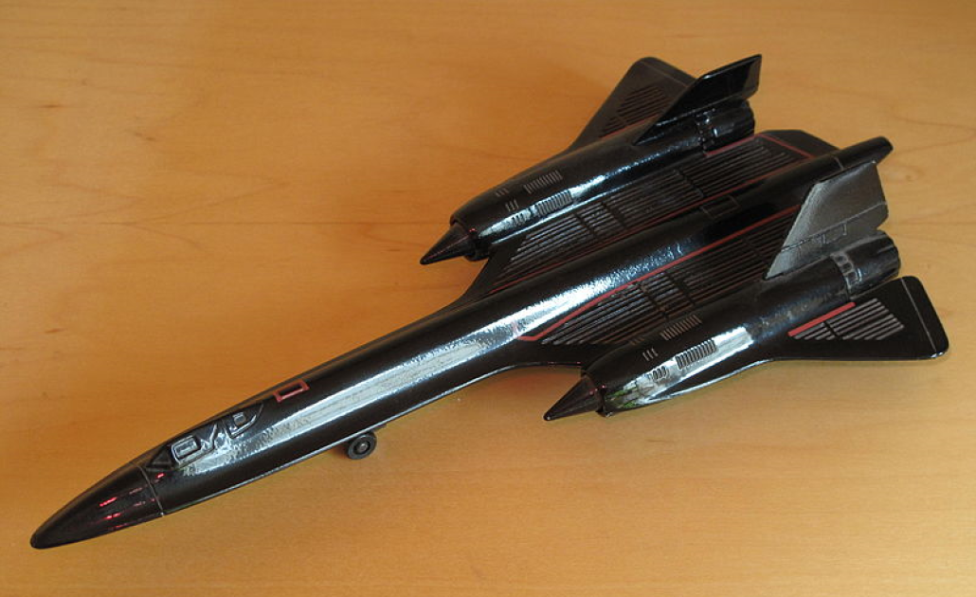
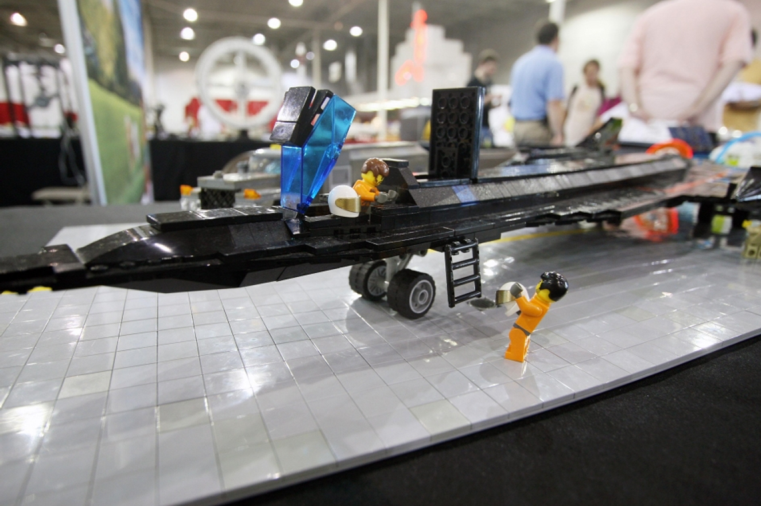
Lego™ not Airfix™ *
IES is not like a traditional data model. It is made up of a few re-usable components that you put together in different ways to make your model. It’s like Lego™ - the model might not exactly as you expected, but the parts move, and you can always change and extend it easily. You can also change small parts without breaking the rest of the model…
…I think that’s enough metaphor stretching for one day…
Image wikimedia commons, author:Tangopaso
Image creative commons, NASA, Maria Werries
*Airfix is a UK model kit company – similar to Revell™, Heller™ or Tamiya™.

Slide 8

Space & Time
IES is a 4D model. Any instance of an IES Element will be something that occupies space and time. The 4D approach allows us to say things about temporal chunks (states) of these Elements. The approach goes further though – extent is the criterion for identity – if two things occupy precisely the same space at the same time, they are the SAME THING. Understanding this is the key to understanding IES.
In the example above, Fred appears to have three different masses. However, each mass is associated with a different state of Fred – i.e. a different point in his life. We’ve also introduced yet another notation here – the space-time diagram.
For more background on the 4D approach (formally, this is b-series four-dimensionalism), refer to:
“How Things Persist”, Katherine Hawley
“Developing High Quality Data Models”, Matthew West
“Business Objects: Re-engineering for Re-use”, Chris Partridge

Slide 9
Space-Time Diagrams
These are used a lot throughout this slide-deck so it’s worth going over the notation.
Space (3D) is shown on the vertical axis – this is largely indicative rather than attempting to be precise. So, larger spatial items will be wider than smaller ones. Things that move in space over time will be diagonal, etc. Things that don’t move (relative to earth) will be horizontal.
Time is on horizontal axis. To represent periods of time, there will be vertical elements on the diagram (i.e. all of space for a period of time)
A period of time extends through all space, for a specific period
Orange element does not move (e.g. a location)
Indented ends indicate the element existed before the time extent shown on the diagram
Pointy ends indicate the element continues to exist beyond the time extent shown on the diagram
Blue element moves into the extent of the orange one (e.g. a person moving into a location). This overlaps with a period of time too – i.e. there is a state of the blue element (the purple section) while it is located in the orange one spatially and in the grey period temporally.
Blue element moves through space then back to its original position

Slide 10
Elements – Back to Fred
Using the instance notation from before, looking at just one of the states of Fred:
KEY:
F ies:Facility
Ma ies:Mass
P ies:Person
PP ies:ParticularPeriod
PS ies:PersonState
ViK ies:ValueInKilograms
Namespaces:
@prefix rdf: <http://www.w3.org/1999/02/22-rdf-syntax-ns#> .
@prefix rdfs: <http://www.w3.org/2000/01/rdf-schema#> .
@prefix ies: <http://ies.data.gov.uk/ies4#> .
@prefix data: <http://data.gov.uk/testdata#> .
@prefix iso8601: http://iso8601.iso.org# .
There’s quite a lot going on here, so let’s break it down a bit.
We have a state of Fred (PS).
The mass (Ma) is linked to the State using the hasCharacteristic relationship. We then state the value of the mass (ViK), and assign the numeric value (25)
We can say where the State was – in this case in a Facility (F) the Acme Health Centre
We can also say where the State was – in this case we only know it happened in between 11:00 and 11:59 on 1992-03-06 as that’s the level of precision we’ve used in the ISO8601 date time. IES allows for a very precise times and dates too, but this is just a simple example
So…using just the States pattern, we’ve been able to say where and when the mass measurement was taken as well as what the mass was.

Slide 11
And repeat…
We can use the same pattern over and over again – including to say where and when Fred was born…

Slide 12
4D Fred
Each of the states is in a ParticularPeriod – each of an hour duration. This allows us to be vague about times – i.e. something happened somewhere in a ParticularPeriod. There are examples to follow where we’re more specific.
ParticularPeriod
1991-03-06T11
1984-09-21T21
2014-12-18T18

Slide 13
Doing Stuff
The IES model has Events – i.e. activities. As the IES is pedantic about space and time, it’s important to define Events that way too. In IES, the extent of a given Event is the sum of all its participations – i.e. the collections of states of things that were participating:
Alice
Team Meeting
Bob
Carole
In the example above, each participant arrived and left at different times. Their states are their participations in the meeting, therefore the states are part of the meeting.

Slide 14
Bounding State
A BoundingState marks the beginning and end of Elements (in this case an EventParticipant)
ParticularPeriod
BoundingState
BoundingState
Team Meeting
2019-04-04T10:00
2019-04-04T11:00
Bob
EventParticipant
In the example above, there is state of Bob (an EventParticipant) where he’s in the team meeting. Because we want to identify the start and end of the state, we book-end it with two BoundingStates. Each of those BoundingStates is in a ParticularPeriod (each a minute long) – i.e. the EventParticipant started some time during that minute.
Note: we could have just put the meeting in the period 2019-04-04T10 (the hour from 10 to 11) but that doesn’t tell us when it started or finished, only that it started and finished in that hour period. The use of BoundingStates enables us to add more precision. We can even do things like say when it started, but be vague about when it finished.

Slide 15
I’ve started so I’ll finish
Started and finished within a given period:
Started, finished, we know when it started, but not when it finished:
Started, finished, we know when it started and finished:
Started, don’t know when, still going:
Started, finished, don’t know when:
All of this is simple construction (mereology) applied to space and time. You can use these simple building blocks to build very complex temporal representations, but all of them founded on a simple, re-usable logic.

Slide 16
Locations
As well as saying when things happen, start and finish, we also want to be able to say where they are. In the Fred example, we had a Facility (Acme Health Centre) as one of the locations:
1991-03-06T11
Acme Health
Centre
weigh-in
Fred
It’s not just Facilities, Locations can be countries, regions of countries, or arbitrary land/sea parcels defined by GeoJSON geometry.
Combining the 4D modelling approach (states) with the locations model gives us a very good way to manage how things (e.g. patients, deliveries, enemy forces, etc.) move around.

Slide 17
Quick Recap
You can say stuff about things at certain times using states
You can say where something was using states and locations
You can say what was involved in Events using states (EventParticipations)
You can be vague or specific about the durations of things
All of this is done using the same, simple constructs that can be connected up to build quite complex pictures of how things change and move over time

